Slide 1


A.Y 2020-2021
Mobile and Cloud Security

Slide 2
Introduction to Mobile Device Security
At present around the world, up to five billion people are using mobile phones
This has led to the rapid increase of cyber criminals
They make use of the information obtained through mobile phones to earn profit and pushing users to become victims of cybercrimes
Hence, mobile users must be aware of the potential threats caused by the cybercriminals as they are usually casted in wide nets

Slide 3









Various Attacks on Mobile Devices
Operating
System Attacks
Mobile App Attacks
Attacks on Mobile Devices
Communication
Network Attacks
Malware Attacks

Slide 4

Components of Mobile Device Security
Endpoint Security
Cloud Access Security Broker (CASB)
Virtual Private Network (VPN)
Mobile Device Security
Email
Security
Secure Web Gateway

Slide 5
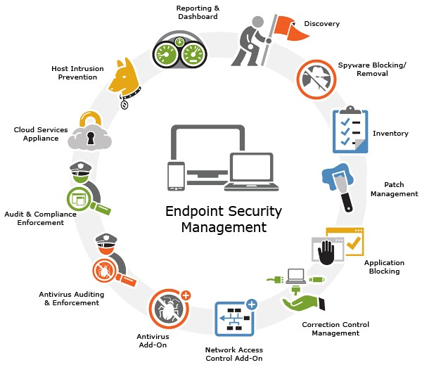
Endpoint security

Slide 6
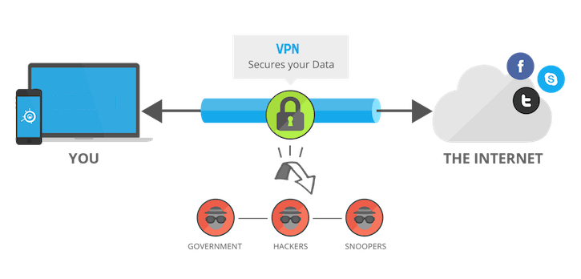
Virtual Private Network (VPN)

Slide 7
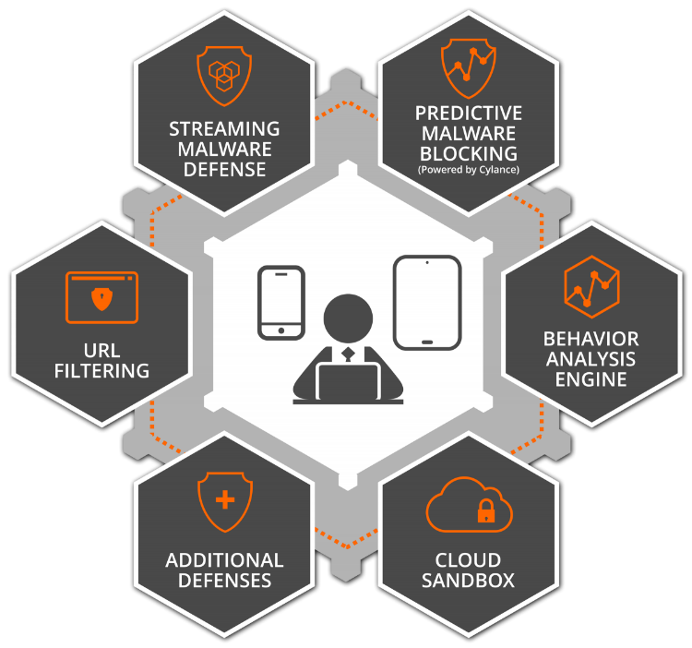
Secure web gateway

Slide 8
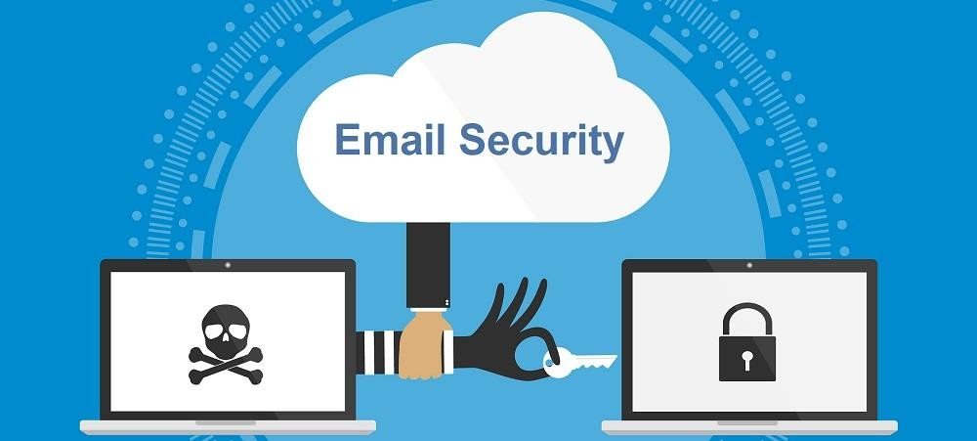
Email security

Slide 9



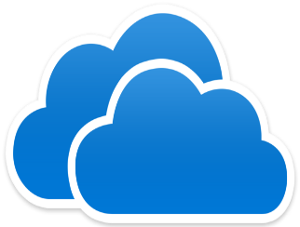

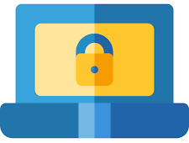

Cloud Access Security Broker (CASB)
End- user organization
CASB Security Controls
Compliance
Secure connection policy Enforcement
Secure connection policy Enforcement
Data Security
Threat
Protection
Cloud services
Data Loss Prevention

Slide 10

Common Mobile Device Security Threats
Data Leakage
Improper Session Handling
Unsecured Wi-Fi
Mobile Device Security Threats
Broken Cryptography
Network Spoofing
Spyware
Phishing Attacks

Slide 11

Common risks in Mobile Devices
Physical
security
Serious threats in new features
Multiple user logging
Malware on rise
Secure data storage
Mobile Device Risks
Bluetooth
attacks
Mobile
browsing
Mobile device coding issues
Application isolation
System
updates

Slide 12


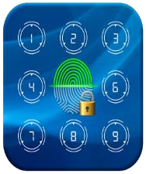
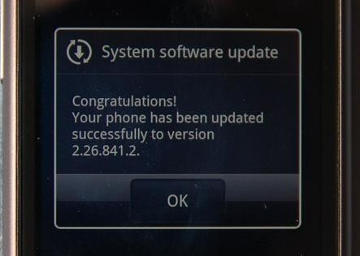
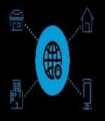
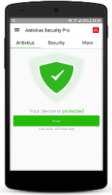
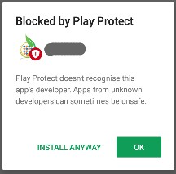
Steps to maintain Mobile Device Security
Safe disposal of old
devices
Locking
phone’s screen
Setting up password’s and user privileges
Mobile Device
Security
Keeping the devices up-to-date
Using secure networks
Downloading apps from trusted sources
Installing anti- virus software

Slide 13
Cloud Security
Cloud computing is one of the promised leading computing technologies
The emergence of cloud users has increased in IT sectors
The security in cloud refers to the process of securing data and information present in the cloud
Cloud computing security processes should address the security controls
The cloud provider incorporates to maintain the customer's data security, privacy and compliance with necessary regulations

Slide 14

Basic Cloud Security Protection Measures
Basic Cloud Security Protection Measures
Ensure the safety of Data and Systems
Identify unusual Behaviors
Examine the latest
security state
Keep track and react to unpredicted events

Slide 15
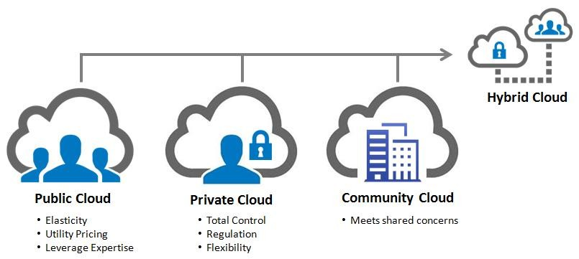
Cloud Deployment Models

Slide 16
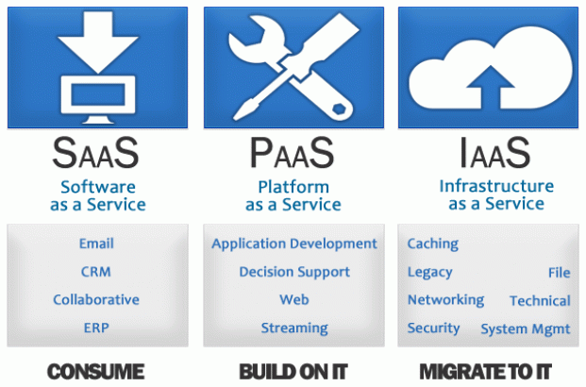
Cloud Service Models

Slide 17
Cloud Service Models
Apart from SaaS, IaaS and PaaS other two service models are also available. They are
Human-as-a-Service (HuaaS)
It provides human resources as a service to the cloud users for predicting massive-scale data and aggregate their information
Everything-as-a-Service (XaaS)
It provides “everything” as a service for the users to consume

Slide 18






The Key Aspects of Cloud Security
Management
Cloud security
Technology
Operation

Slide 19
The Key Aspects of Cloud Security Management
Alteration of security policies
Cloud security strategy
Cloud security governance
Cloud security processes
Security roles & responsibilities
Cloud security guidelines
Cloud security assessment
Service integration
IT & procurement security requirements
Cloud security management

Slide 20
The Key Aspects of Cloud Security Operation
Awareness and training programs on cloud security
Incident management
Configuration management
Contingency planning
Maintenance
Media protection
Environmental protection
System integrity
Information integrity
Personnel security

Slide 21
The Key Aspects of Cloud Security Technology
Access control Technology and software configuration
System Protection Technology
Authentication Technology
Cloud security audits
Identity and key management
Physical security protection
Backup recovery and archive
Core infrastructure

Slide 22

Risks in Cloud Security
Loss or Theft of Intellectual Property
Compliance of violations and regulatory actions
Loss of control over under user actions
Malware infections that unleash a
targeted attack
Cloud Security Risks
Contractual breaches with customer or business
partners
Diminished customer trust
Data breach requiring disclosure and notification to victims
Increased customer churn
Revenue losses

Slide 23
Tools used in Cloud security
OpenStack is an open source software used for creating private and public clouds
Users can create virtual machines and other instances that do different things in the cloud environment
It allows users to quickly create new VM or instance upon which other cloud components can run providing infrastructure
This puts OpenStack in the Cloud Infrastructure as a Service category

Slide 24
Steps towards an Effective Cloud Security Team
Developing a Cloud Security Strategy
Focusing on Federated Model Moving closer to contracts and business
Managing multiplicity Securing the exit Building diverse teams
Seeking out Security Standards

Slide 25
Conclusion
As the world is moving towards a digital era, users increasingly started using mobile devices and the cloud services
Despite having many advantages, these services are also open doors to threats and vulnerabilities
The users must be educated with proper knowledge of using mobile devices and its related applications to prevent themselves from hacking of resources
The users should also be aware of selecting and using cloud resources and services

Slide 26
Thank you!

